Slide 1

Deep Learning
Session 26
Multi Topic Overview
Applied Data Science
2024/2025

Slide 2
Multimodal Neural Networks

Slide 3
What is Multimodal Learning?
In general, learning that involves multiple modalities
This can manifest itself in different ways:
Input is one modality, output is another
Multiple modalities are learned jointly
One modality assists in the learning of another
...
Multi Topic Overview
Session 26

Slide 4
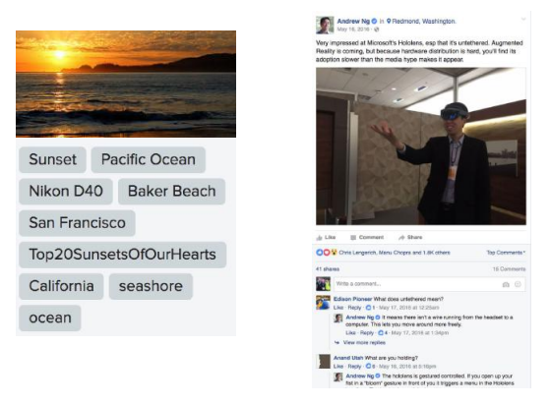
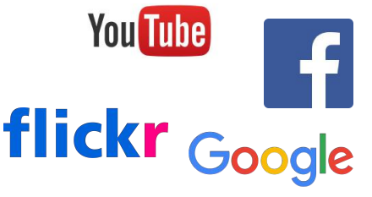
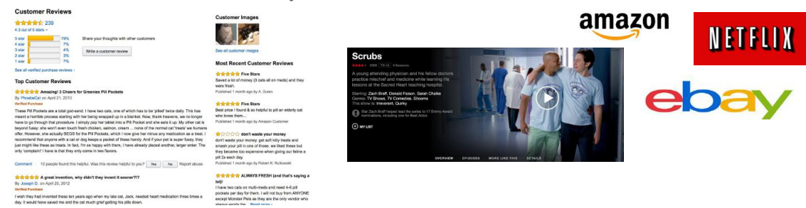
Multimodal Data
Data is usually a collection of modalities
Multi Topic Overview
Session 26

Slide 5
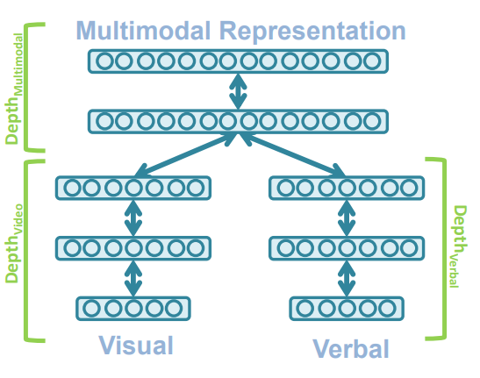
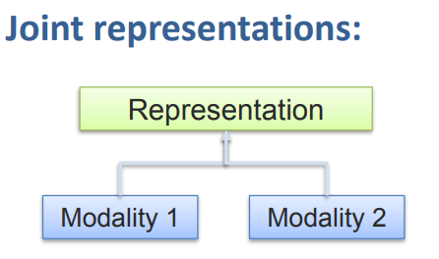
Why is Multimodal Learning Hard?
Different representations
Learning how to represent and summarize multimodal data in away that exploits the complementarity and redundancy.
Multi Topic Overview
Session 26

Slide 6
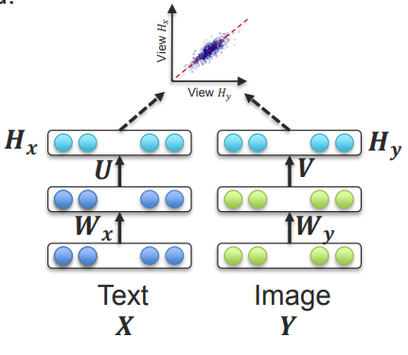
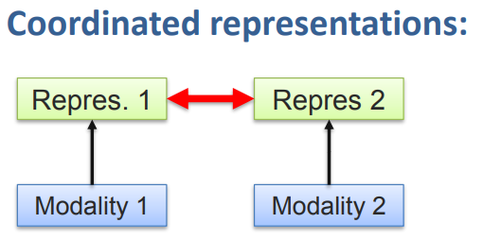
Why is Multimodal Learning Hard?
Different representations
Learning how to represent and summarize multimodal data in away that exploits the complementarity and redundancy.
Multi Topic Overview
Session 26

Slide 7
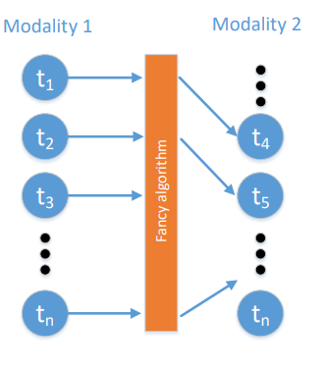
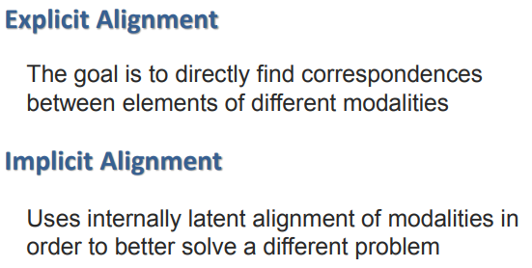
Why is Multimodal Learning Hard?
Alignment
Identify the direct relations between (sub)elements from two or more different modalities.
Multi Topic Overview
Session 26

Slide 8
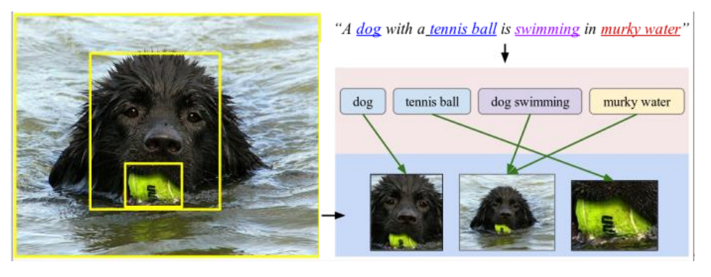
Implicit Alignment
Multi Topic Overview
Session 26

Slide 9
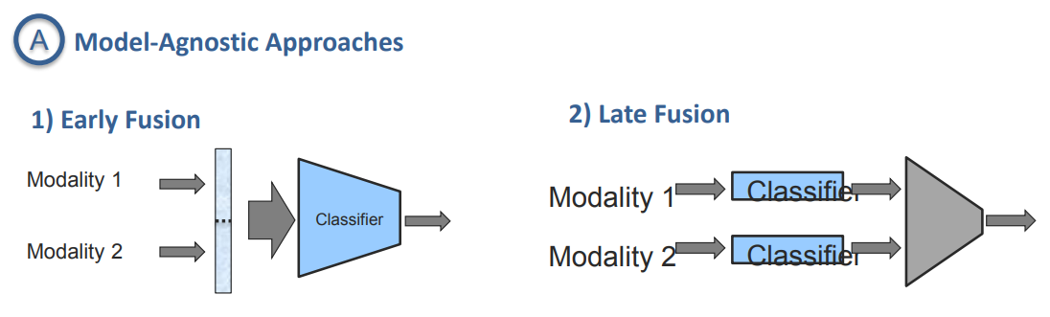
Why is Multimodal Learning Hard?
Fusion
To join information from two or more modalities to perform a prediction task.
Multi Topic Overview
Session 26

Slide 10
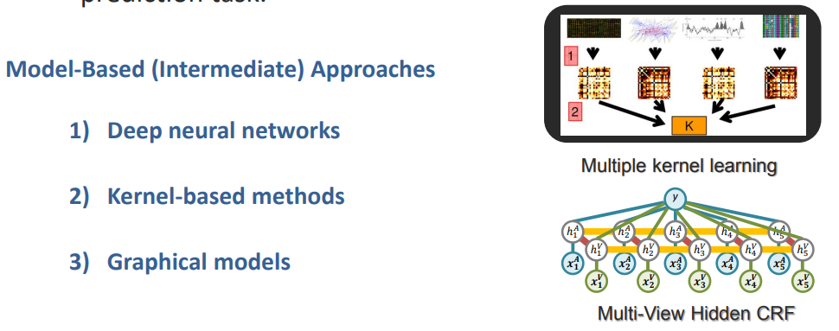
Why is Multimodal Learning Hard?
Fusion
To join information from two or more modalities to perform a prediction task.
Multi Topic Overview
Session 26

Slide 11
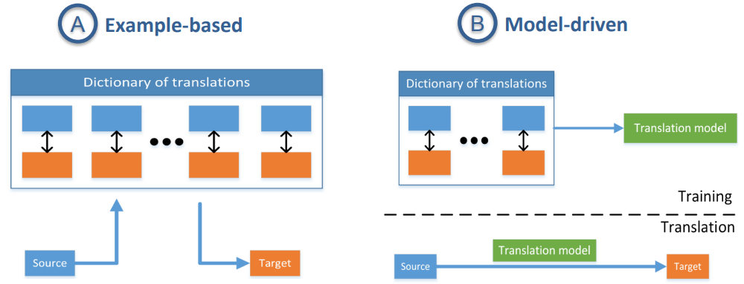
Why is Multimodal Learning Hard?
Translation
Process of changing data from one modality to another, where the translation relationship can often be open-ended or subjective.
Multi Topic Overview
Session 26

Slide 12
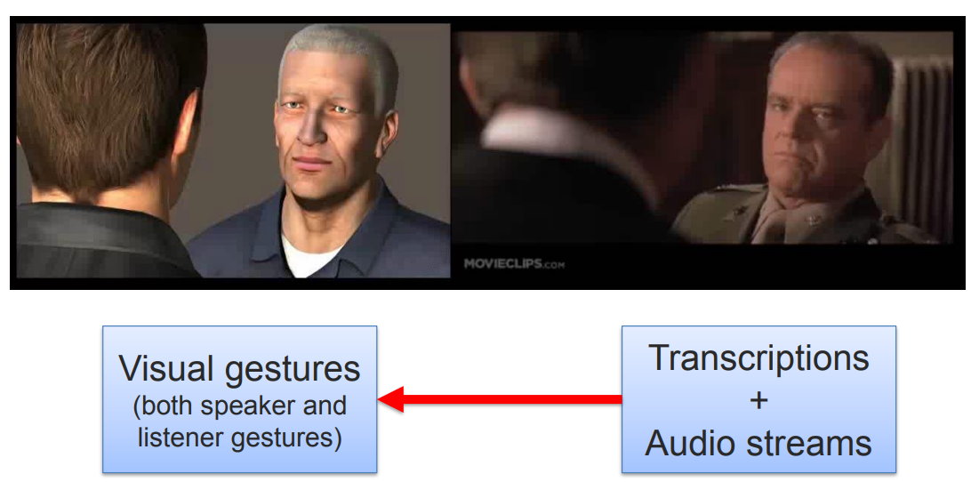
Why is Multimodal Learning Hard?
Translation
Process of changing data from one modality to another, where the translation relationship can often be open-ended or subjective.
Multi Topic Overview
Session 26

Slide 13
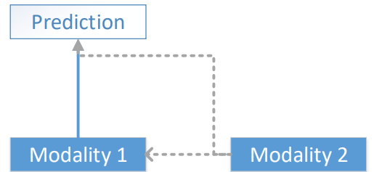
Why is Multimodal Learning Hard?
Co-Learning:
Transfer knowledge between modalities, including their representations and predictive models.
Multi Topic Overview
Session 26

Slide 14
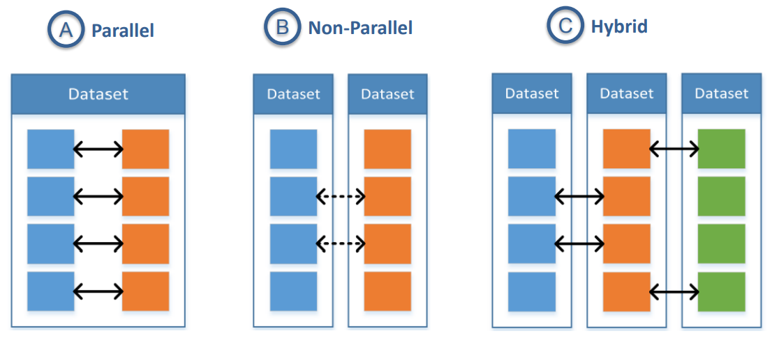
Why is Multimodal Learning Hard?
Co-Learning:
Transfer knowledge between modalities, including their representations and predictive models.
Multi Topic Overview
Session 26

Slide 15
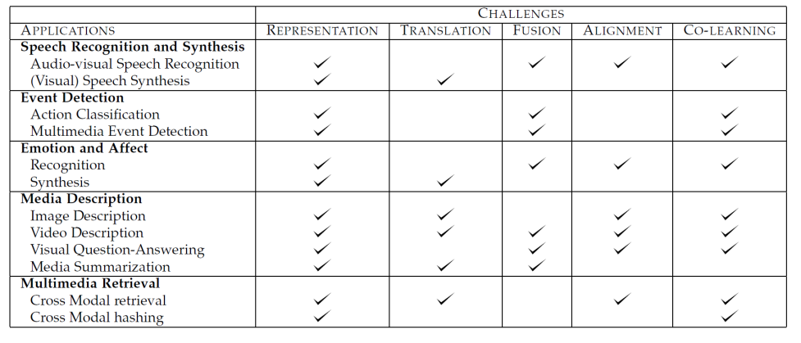
Multimodal Applications
Multi Topic Overview
Session 26

Slide 16
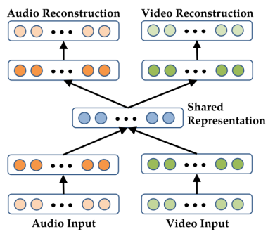
Deep Multimodal Autoencoders
A deep representation learning approach
A bimodal auto-encoder
Used for Audio-visual speech recognition
Multi Topic Overview
Session 26

Slide 17
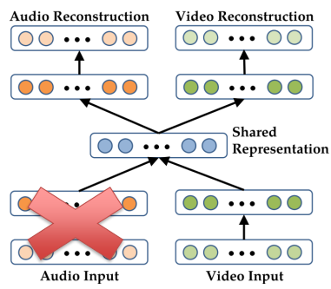
Deep Multimodal Autoencoders
A deep representation learning approach
A bimodal auto-encoder
Used for Audio-visual speech recognition
Multi Topic Overview
Session 26

Slide 18
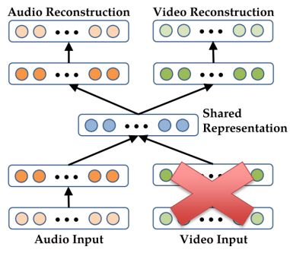
Deep Multimodal Autoencoders
A deep representation learning approach
A bimodal auto-encoder
Used for Audio-visual speech recognition
Multi Topic Overview
Session 26

Slide 19
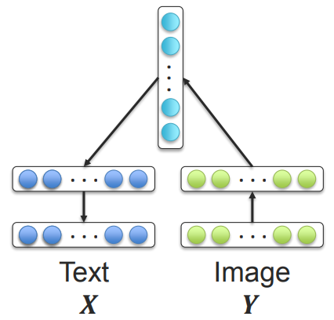
Multimodal Encoder-Decoder
Visual modality often encoded using CNN
Language modality will be decoded using LSTM
A simple multilayer perceptron will be used to
translate from visual (CNN) to language (LSTM)
Multi Topic Overview
Session 26

Slide 20
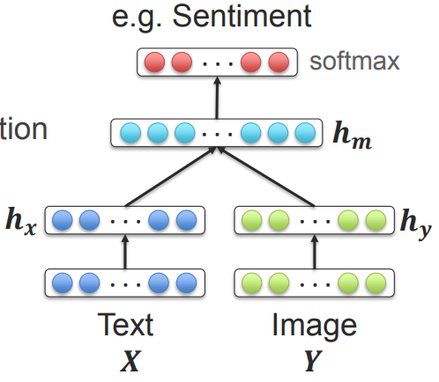
Multimodal Joint Representation
For supervised learning tasks
Joining the unimodal representations
Simple concatenation
Element-wise multiplication or summation
Multilayer perceptron
Multi Topic Overview
Session 26

Slide 21
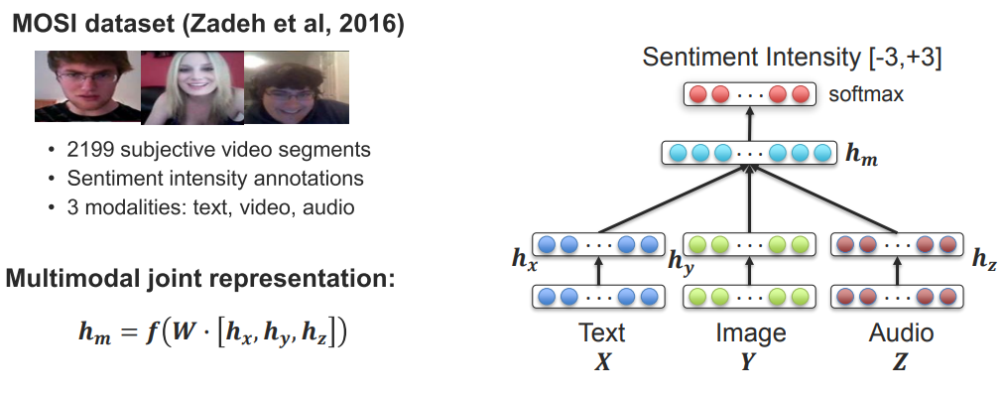
Multimodal Sentiment Analysis
Multi Topic Overview
Session 26

Slide 22
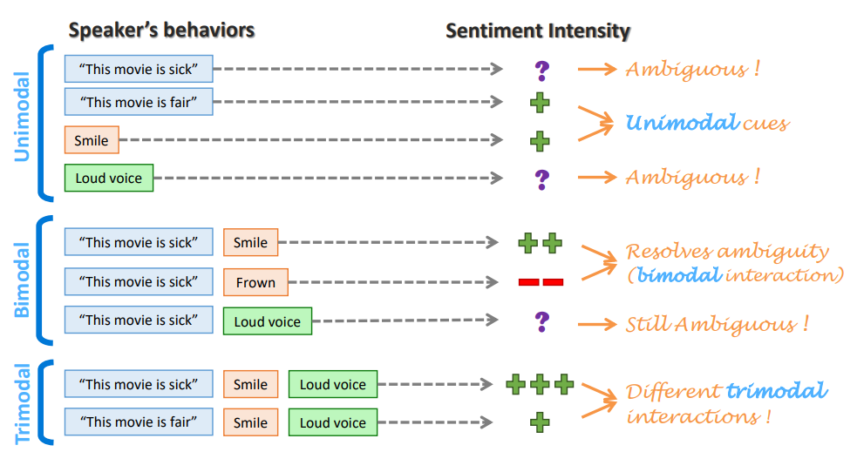
Unimodal, Bimodal and Trimodal Interactions
Multi Topic Overview
Session 26

Slide 23
Transfer Learning

Slide 24
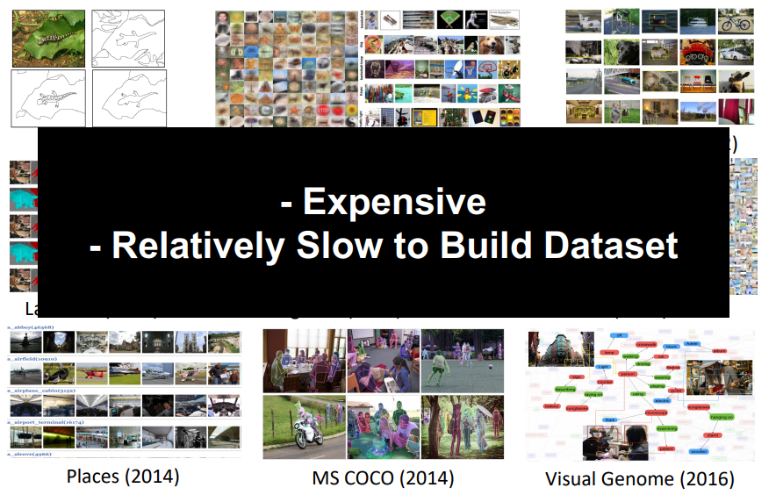
Transfer Learning
Goal: : Avoid Always Relying on Large Labeled Datasets
Multi Topic Overview
Session 26

Slide 25
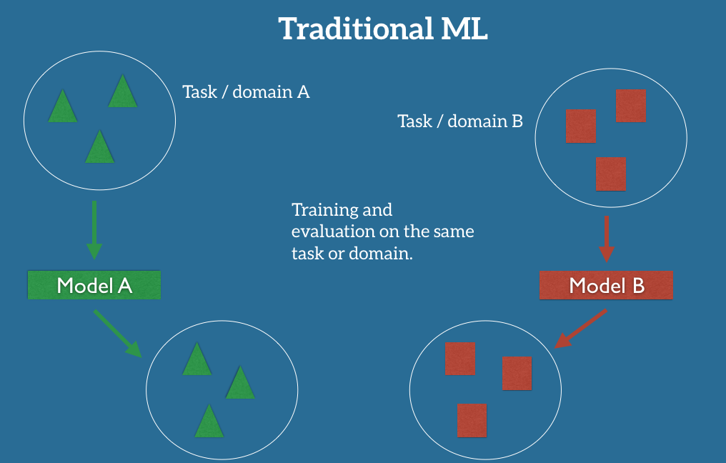
Transfer Learning
Rather than Learn Solution from Scratch For Each Task/Domain Pair …
Multi Topic Overview
Session 26

Slide 26
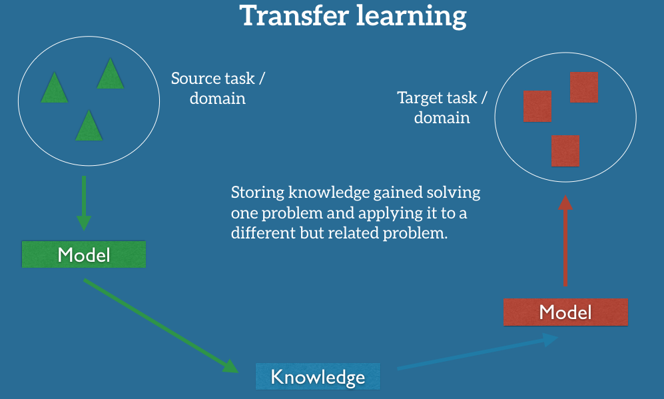
Transfer Learning
… Improve the Learning for Conditions Not Observed During Training.
Multi Topic Overview
Session 26

Slide 27
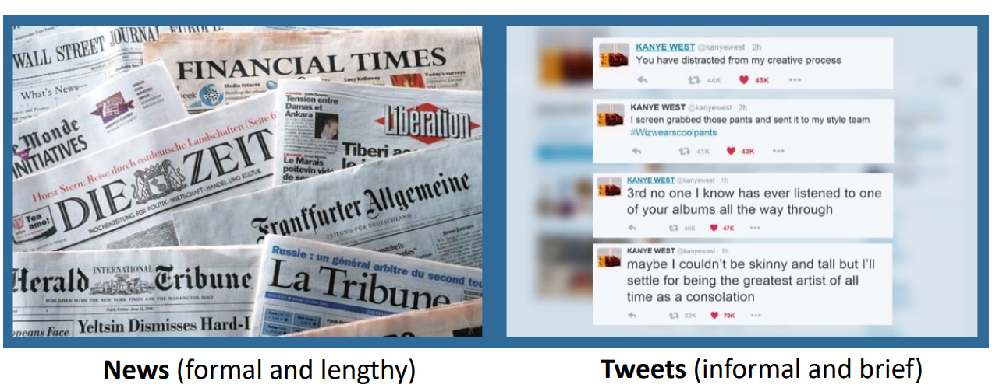
Transfer Learning
Transfer Learning When Data Sampling Changes (e.g., Sentiment Classification)
Multi Topic Overview
Session 26

Slide 28

Transfer Learning
Transfer Learning When Feature Space Changes (e.g., Sentiment Classification in Different Language)
Multi Topic Overview
Session 26

Slide 29
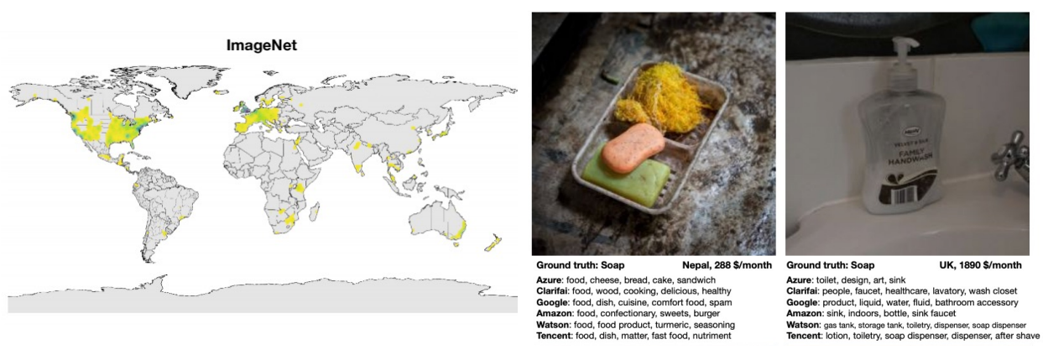
Transfer Learning
Transfer Learning When Target Categories Change (e.g., Items in Low Income Household vs ImageNet)
Multi Topic Overview
Session 26

Slide 30
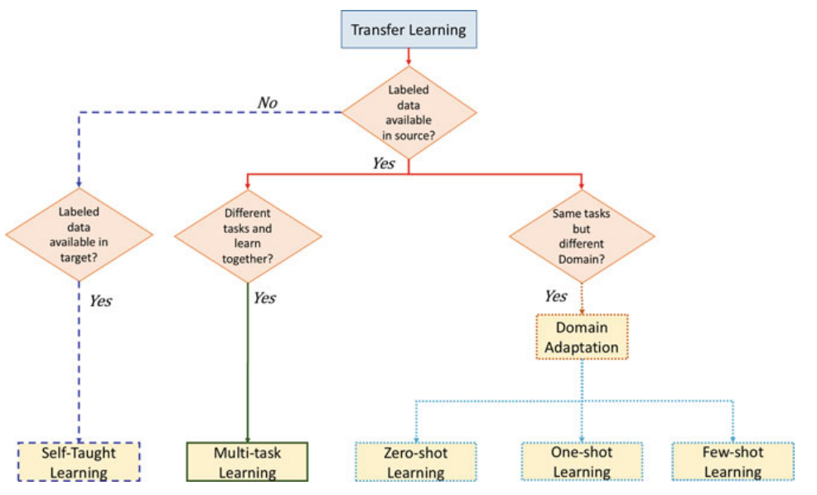
Transfer Learning Approaches
Multi Topic Overview
Session 26

Slide 31
Transfer Learning: Key Challenges
What to transfer? i.e., what knowledge generalizes
How to transfer?
When to transfer? i.e., transferring knowledge can harm performance
Multi Topic Overview
Session 26

Slide 32
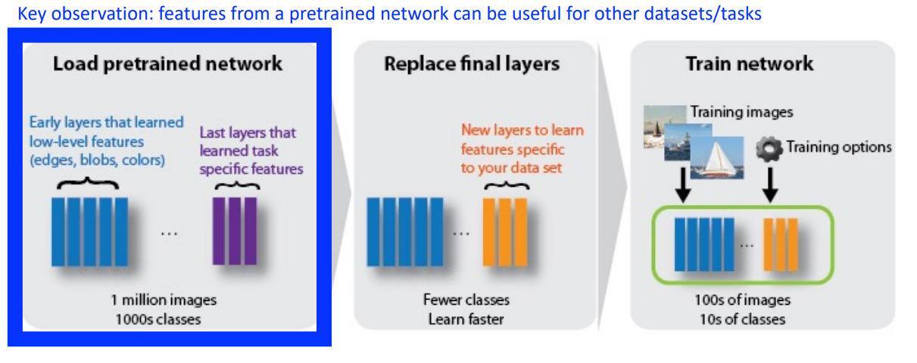
Transfer Learning: Self-Supervised
Goal: create generalizable features
Multi Topic Overview
Session 26

Slide 33
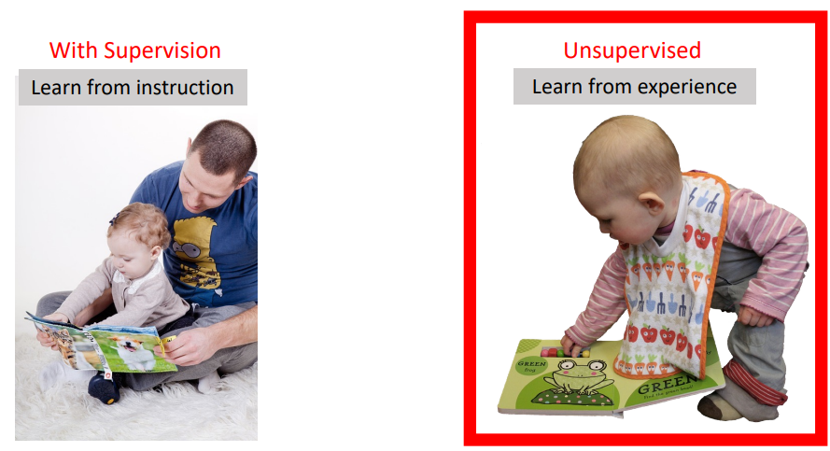
Transfer Learning: Self-Supervised
How Do Humans Learn?
Multi Topic Overview
Session 26

Slide 34
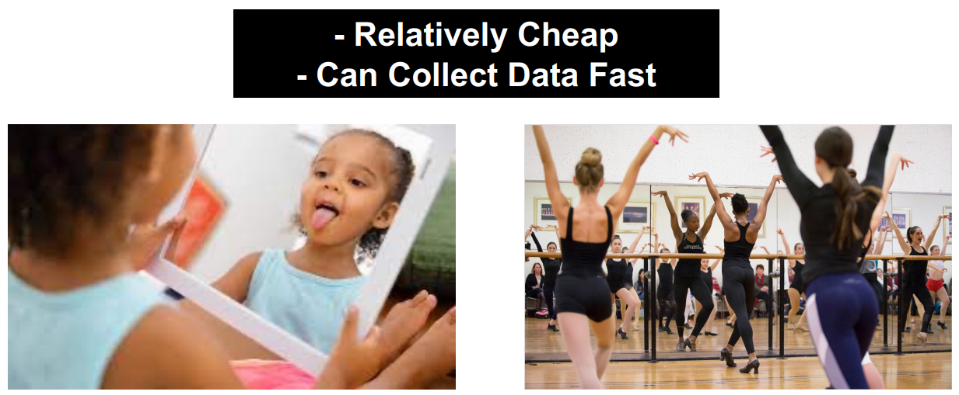
Self-Supervised Learning
Data Gives Supervision
Multi Topic Overview
Session 26

Slide 35
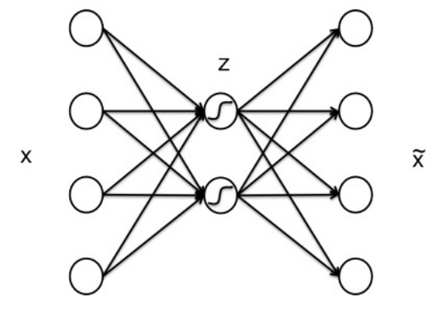
Autoencoders
Learn to copy the input to the output
Multi Topic Overview
Session 26

Slide 36
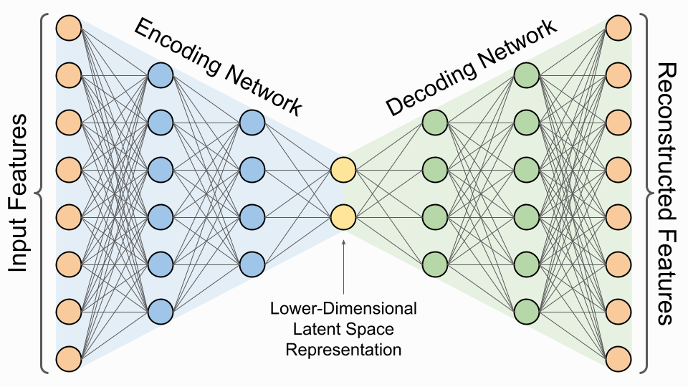
Autoencoders
Consists of two parts:
Encoder: compresses the input to na internal representation
Decoder: tries to reconstruct the input from the internal representation
Multi Topic Overview
Session 26

Slide 37
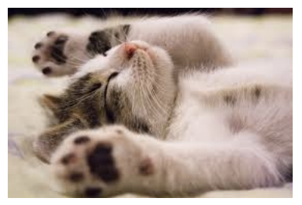
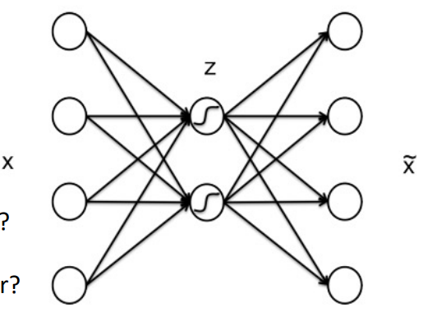
Image Autoencoder Architecture
Given this input 620 x 426 image (264,120 pixels):
What would a perfect autoencoder predict?
Multi Topic Overview
Session 26

Slide 38
Image Autoencoder Architecture
Given this input 620 x 426 image (264,120 pixels):
What would a perfect autoencoder predict?
itself
Multi Topic Overview
Session 26

Slide 39
Image Autoencoder Architecture
Given this input 620 x 426 image (264,120 pixels):
What number of nodes are in the final layer?
Multi Topic Overview
Session 26

Slide 40
Image Autoencoder Architecture
Given this input 620 x 426 image (264,120 pixels):
What number of nodes are in the final layer?
264,120
Multi Topic Overview
Session 26

Slide 41
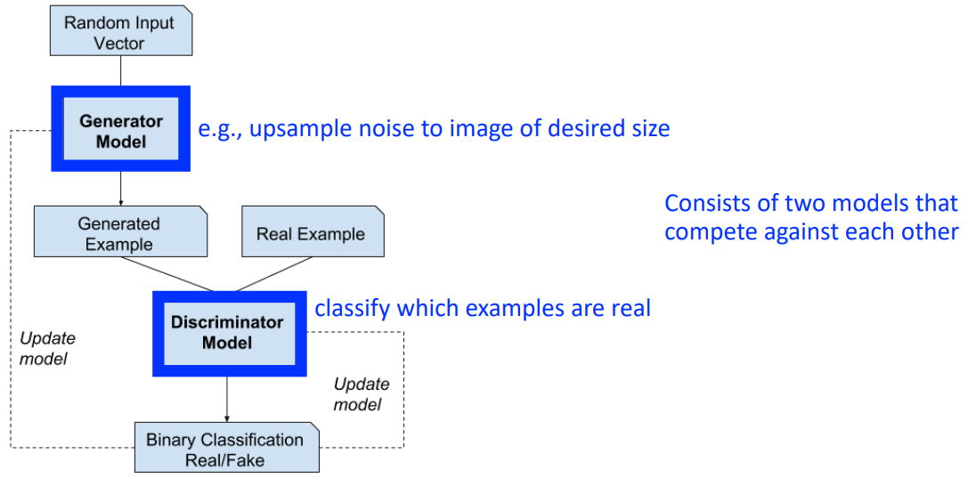
Generative Adversarial Networks (GANs)
Multi Topic Overview
Session 26

Slide 42
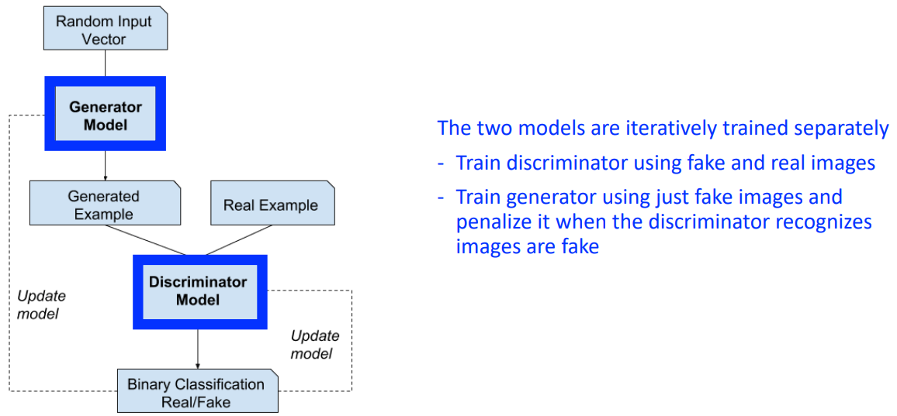
GAN Training
Multi Topic Overview
Session 26

Slide 43
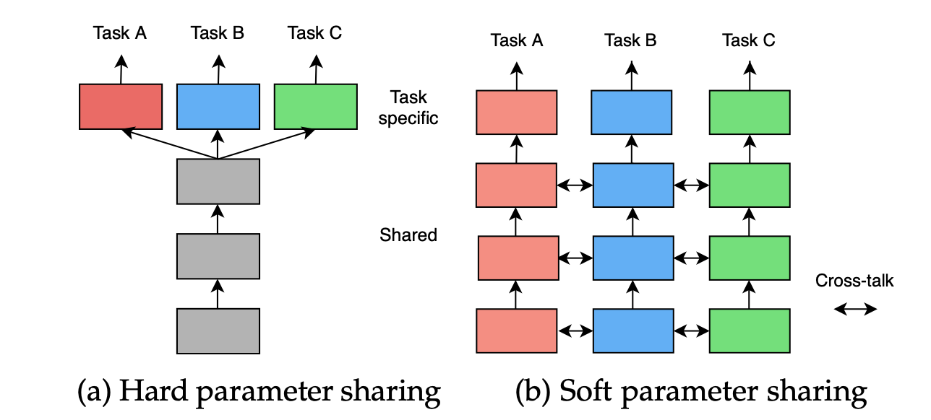
Multi-Task Learning
Multi Topic Overview
Session 26

Slide 44
Multi-Task Learning
General Benefits from Parameter Sharing?
Data augmentation
Enables features found for one task to be available for another
Emphasizes generalizable features that are common across tasks
Multi Topic Overview
Session 26

Slide 45
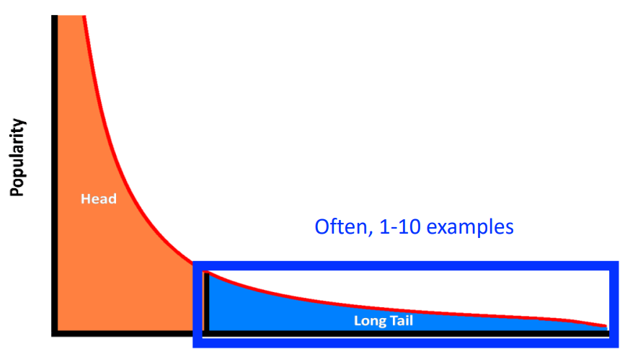
Zero/Few-Shot Learning
Problem Set-up: Learn from Few Examples
Multi Topic Overview
Session 26

Slide 46
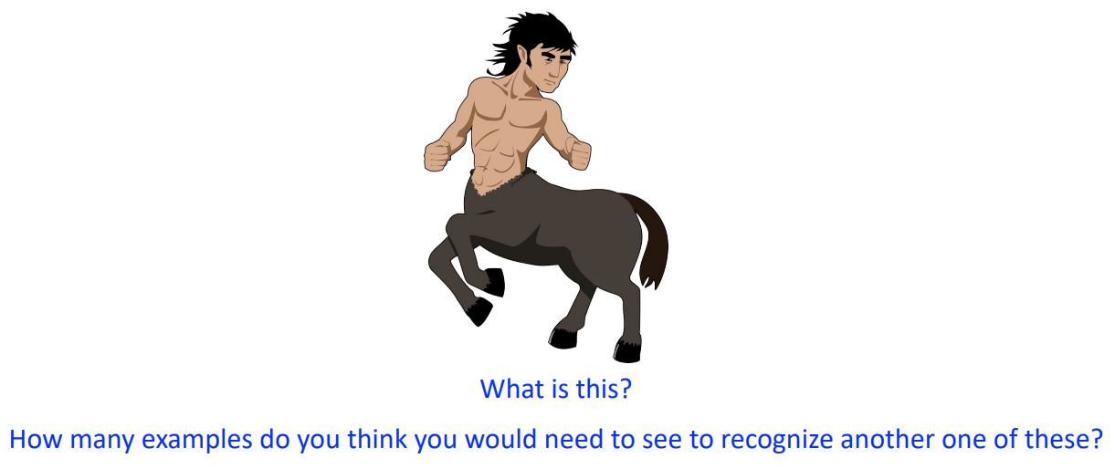
Zero/Few-Shot Learning
Intuition: Generalize Current Knowledge to Quickly Generalize to New Categories
Multi Topic Overview
Session 26

Slide 47
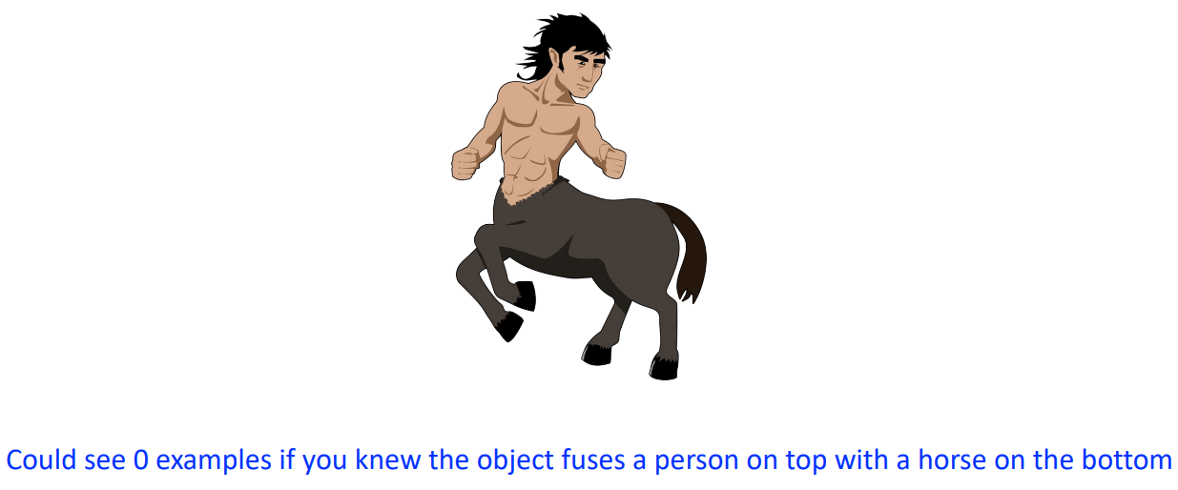
Zero/Few-Shot Learning
Intuition: Generalize Current Knowledge to Quickly Generalize to New Categories
Multi Topic Overview
Session 26

Slide 48
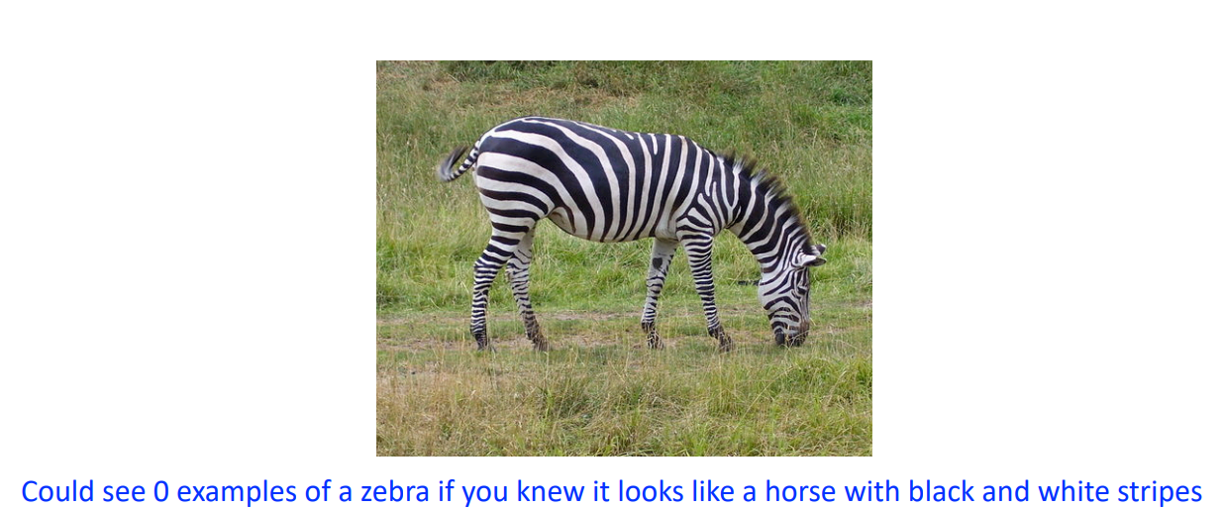
Zero/Few-Shot Learning
Intuition: Generalize Current Knowledge to Quickly Generalize to New Categories
Multi Topic Overview
Session 26

Slide 49
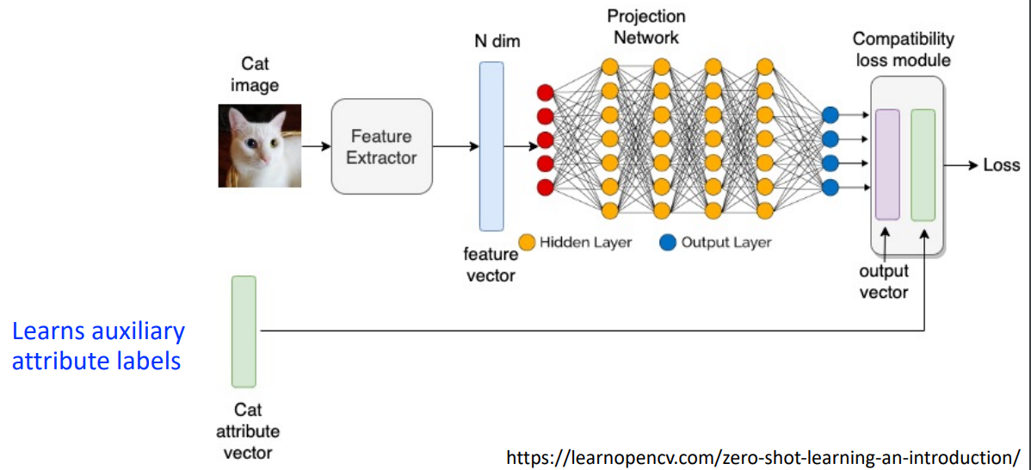
Zero/Few-Shot Learning
Key Idea: Learn from Auxiliary Labels How to Perform a Different Task with Zero/Few Training Examples
Multi Topic Overview
Session 26

Slide 50
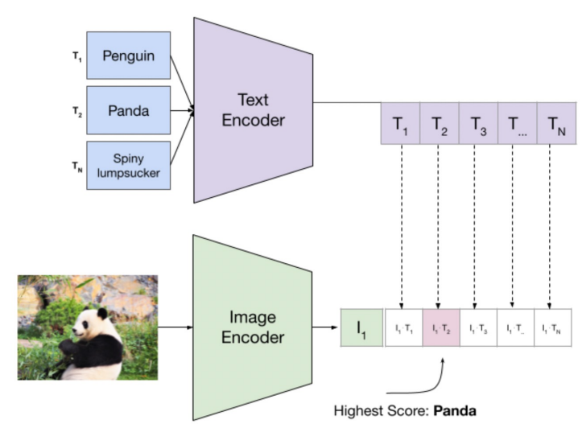
Zero/Few-Shot Learning
Contrastive Language-Image Pretraining (CLIP)
Multi Topic Overview
Session 26

Slide 51
Efficient Learning

Slide 52
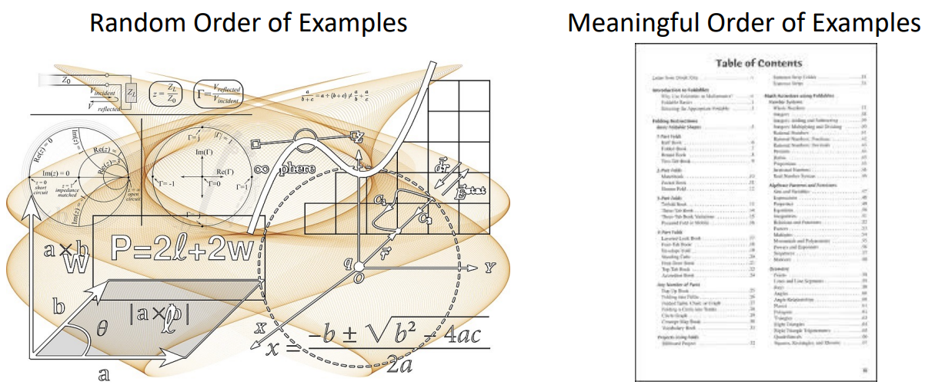
Efficient Learning
How to teach machines so they learn faster?
Multi Topic Overview
Session 26

Slide 53
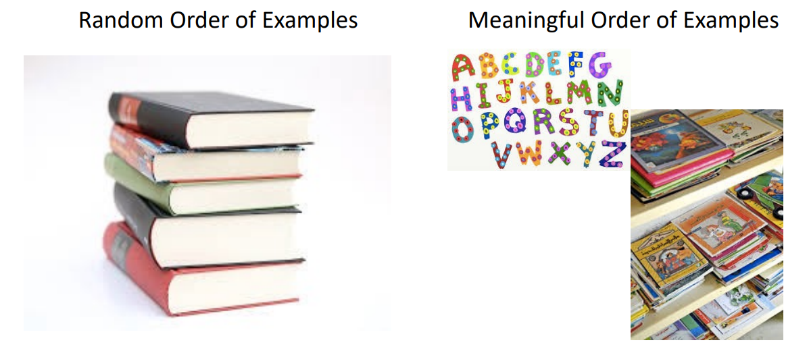
Efficient Learning
Intuition: How to Teach a Child To Read?
Multi Topic Overview
Session 26

Slide 54
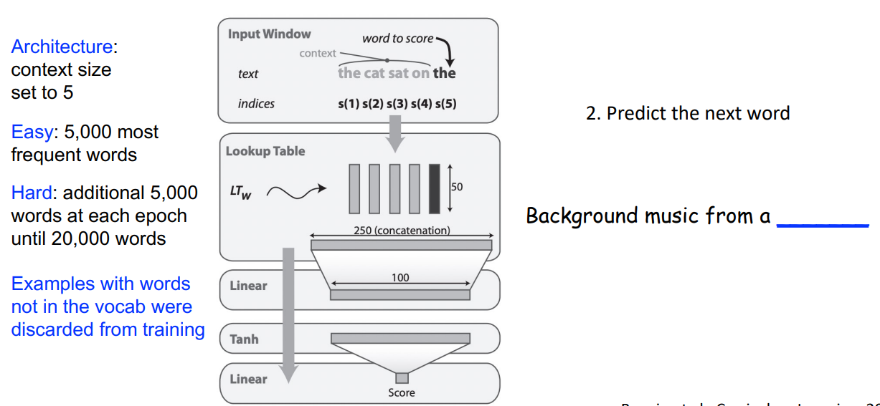
Efficient Learning
Curriculum Learning
Multi Topic Overview
Session 26

Slide 55
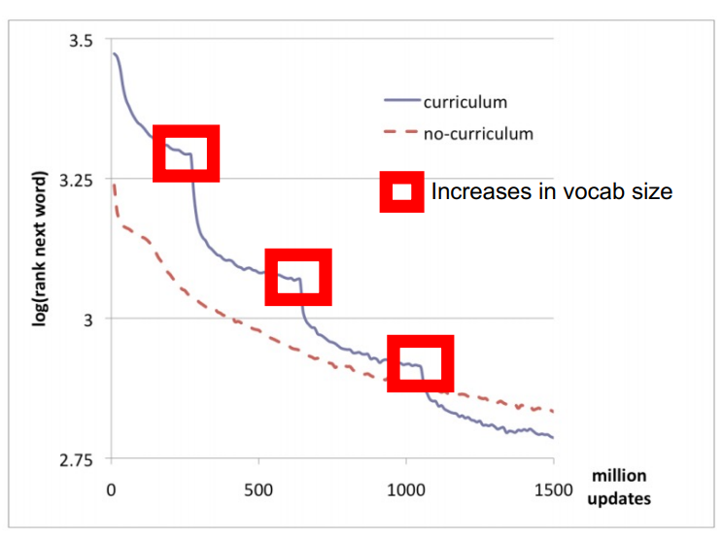
Efficient Learning
Curriculum Learning: Next Word Prediction
Multi Topic Overview
Session 26

Slide 56

Efficient Learning
Active Learning:
Actively select the examples to label that would be most effective for learning rather than labelling all available data.
Types of Active Learning:
Multi Topic Overview
Session 26

Slide 57
Reinforcement Learning

Slide 58

Reinforcement Learning
Agent takes actions in na environment to maximize the total reward
Multi Topic Overview
Session 26

Slide 59

Reinforcement Leraning
Intuition: Learning to Walk by Trial-and Error
Multi Topic Overview
Session 26

Slide 60

Reinforcement Learning Applications
Multi Topic Overview
Session 26

Slide 61

Reinforcement Learning Applications
Multi Topic Overview
Session 26

Slide 62

Reinforcement Learning Applications
Multi Topic Overview
Session 26

Slide 63

Reinforcement Learning Applications
Pong Game Learning Example
Goal: compute optimal “up” and “down” paddle movements to maximize rewards
Multi Topic Overview
Session 26

Slide 64

Reinforcement Learning Applications
Pong Game Learning Example
Multi Topic Overview
Session 26

Slide 65

Reinforcement Learning Applications
Pong Game Learning Example
Given game state (as image), decide if to move paddle up or down
Multi Topic Overview
Session 26

Slide 66
Reinforcement Learning Applications
Pong Game Learning Example
Reward provided after each game state of moving paddle up or down
Multi Topic Overview
Session 26

Slide 67
Reinforcement Learning Applications
Pong Game: Policy Network
Problem: reward may be due to good action many steps ago
Multi Topic Overview
Session 26

Slide 68

Reinforcement Learning Applications
Pong Game: Training Protocol
Encourages actions that eventually lead to good outcomes and discourages actions that eventually lead to bad outcomes by updating gradients accordingly
Multi Topic Overview
Session 26

